Slide 1
Azure Responsible AI dashboard (workshop) <<instructor>>

Slide 2




The world today…
AI innovation is occurring at a rapid pace
Companies are accelerating adoption of AI
Societal expectations are evolving
Governments are regulating AI in response
Notes:
[Talking points]
AI is here, today all around us, helping to make our lives more convenient, productive, and even entertaining. It’s finding its way into some of the most important systems that affect us as individuals, across our lives, from healthcare, finance, education, and employment.
Organizations have recognized that AI is poised to transform business and society, the advancements in AI along with the accelerated adoption are being met with evolving societal expectations and growing regulation in response.
AI is complex because it is not a single thing, but a constellation of technologies that can be put to many different uses, with vastly different consequences.
AI has unique challenges that we need to respond to and to take steps toward a better future, we need to define new rules, norms, and practices.

Slide 3
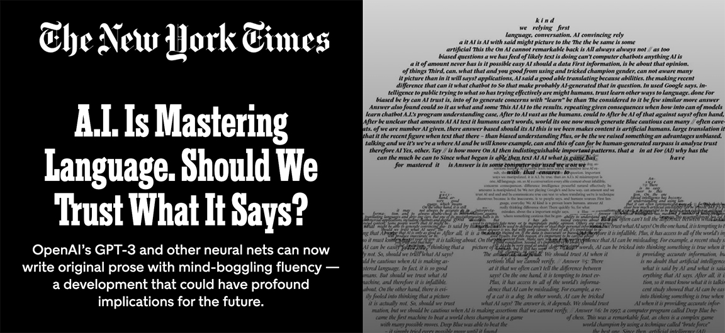

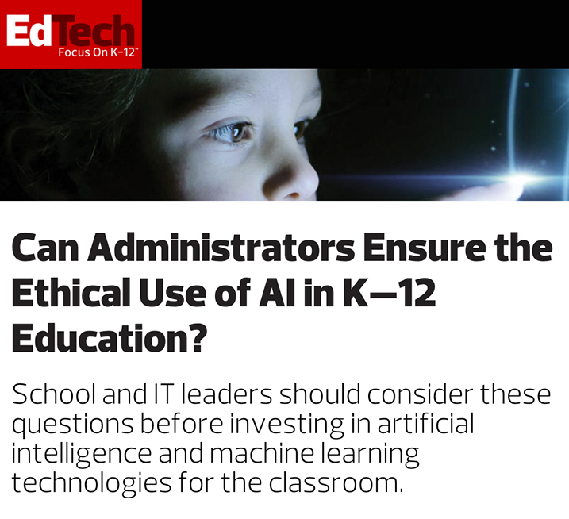
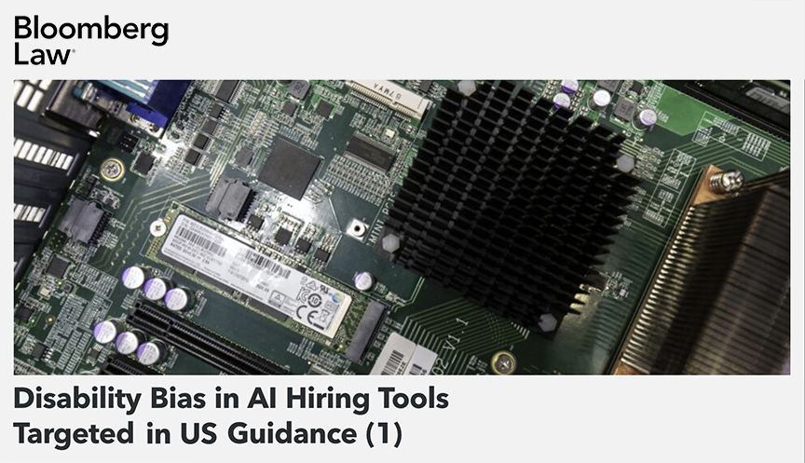
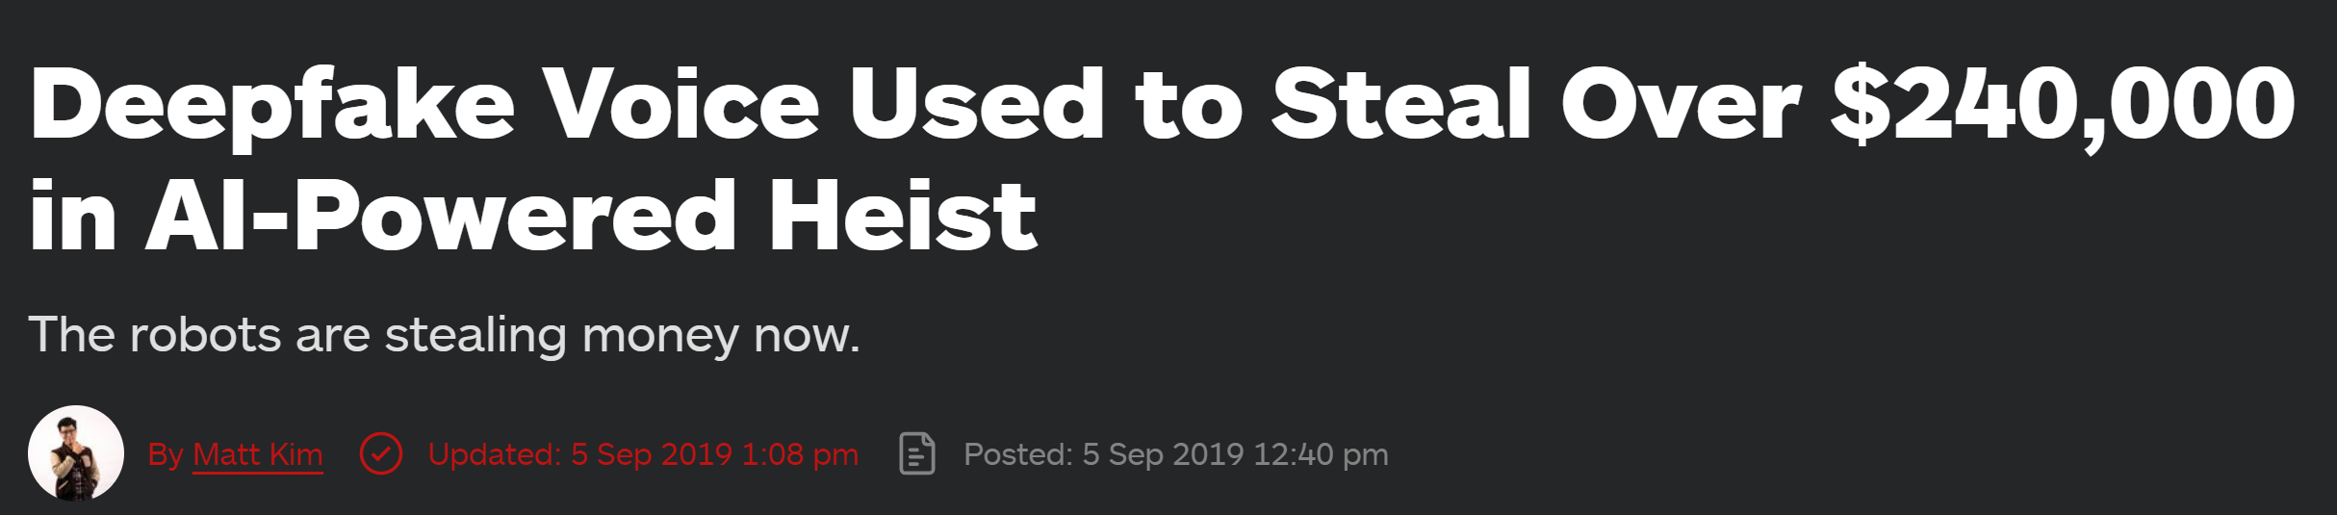
Societal expectations are increasing
Notes:
Cutting-edge technology is not staying in the labs, more and more AI is being put to work in applications that affect us as individuals and members of society. On a weekly basis there are new headlines highlighting the concerns regarding the use or misuse of AI. Societal expectations are growing: more members of society are considering whether AI is trustworthy and what companies are innovating with their concerns in mind.

Slide 4



Why Responsible AI?
AI systems continue to miss expectations.
New AI breakthroughs expose new challenges.
Government regulation
on AI imminent.
Notes:
Challenges we face with the breakthroughs in AI:
AI systems continue to miss expectations.
New AI breakthroughs expose new challenges.
- Governments are regulating AI in response

Slide 5
Learn Microsoft's AI principles
Fairness
Reliability
& Safety
Privacy &
Security
Inclusiveness
Transparency
Accountability
Notes:
Microsoft’s AI Principles
Guidance: The purpose of this slide is to showcase the six core ethical recommendations in The Future Computed that represents Microsoft view on AI. Microsoft believes that the development and deployment of AI must be guided by the creation of an ethical framework. We set out our view in The Future Computed that there are six core principles that should guide the work around AI. Four core principles of fairness, reliability & safety, privacy & security, and inclusiveness, underpinned by two foundational principles of transparency and accountability
At Microsoft, we began our AI governance work by adopting a set of principles in January 2018.
The first principle is fairness. For AI, this means that AI systems should AI systems should treat everyone fairly and avoid affecting similarly situated groups of people in different ways. For example, when AI systems provide guidance on medical treatment, loan applications, or employment, they should make the same recommendations to everyone with similar symptoms, financial circumstances, or professional qualifications.
The second principle is reliability and safety. To build trust, it’s also important that AI systems operate reliably, safely, and consistently under normal circumstances and in unexpected conditions. How they behave and the variety of conditions they can handle reliably and safely largely reflects the range of situations and circumstances that developers anticipate during design and testing. We have been designing software engineering systems to be reliable and safe for years. We need to understand that engineering probabilistic systems are different. AI systems, by their very nature, have errors.
It’s also crucial to develop AI systems that can protect private information and resist attacks. As AI becomes more prevalent, protecting privacy and securing important personal and business information is becoming more critical and complex. Privacy and data security issues require especially close attention for AI because access to data is essential for AI systems to make accurate and informed predictions and decisions about people. As an industry we have made significant advancements in Privacy & security, fueled significantly by regulations like the GDPR. Yet with AI systems we must acknowledge the tension between the need for more personal data to make systems more personal and effective – and privacy. Just like with the birth of connected computers with the internet, we are also seeing a huge uptick in the number of security issues related to AI. At the same time, we have seen AI being used to improve security. As an example most modern anti-virus scanners are driven by AI heuristics today. We need to ensure that our Data Science processes blend harmoniously with the latest privacy and security practices.
For the 1 billion people with disabilities around the world, AI technologies can be a game-changer. AI can improve access to education, government services, employment, information, and a wide range of other opportunities. Inclusive design practices can help system developers understand and address potential barriers in a product environment that could unintentionally exclude people. By addressing these barriers, we create opportunities to innovate and design better experiences that benefit everyone. AI has the potential to make computer systems more accessible to those who cannot access computers today. AI must be developed and deployed in a way that can benefit all and is accessible by all. Microsoft’s vision is about democratizing technology and this applies to AI. NOTE this is an opportunity to talk about some of the company’s work in relation to AI for accessibility https://www.microsoft.com/en-us/ai-for-accessibility
When AI systems are used to help inform decisions that have tremendous impacts on people’s lives, it’s critical that people understand how those decisions were made. A crucial part of transparency is what we refer to as intelligibility or the useful explanation of the behavior of AI systems and their components. Improving intelligibility requires that stakeholders comprehend how and why they function so that they can identify potential performance issues, safety and privacy concerns, biases, exclusionary practices, or unintended outcomes. We also believe that those who use AI systems should be honest and forthcoming about when, why, and how they choose to deploy them. Transparency is an important principle as people can’t identify whether progress is being made on the top four principles unless there is enough transparency around how systems have been built and function. It is also paramount to the way these systems are managed, operationalized, and documented.
Our final principle is accountability. We believe the people who design and deploy AI systems must be accountable for how their systems operate. This is perhaps the most important of all the principles. Ultimately one of the biggest questions for our generation, as the first generation that is bringing AI to society, is how to ensure that AI will remain accountable to people and how to ensure that the people that design, build, and deploy AI remain accountable to everyone else.

Slide 6
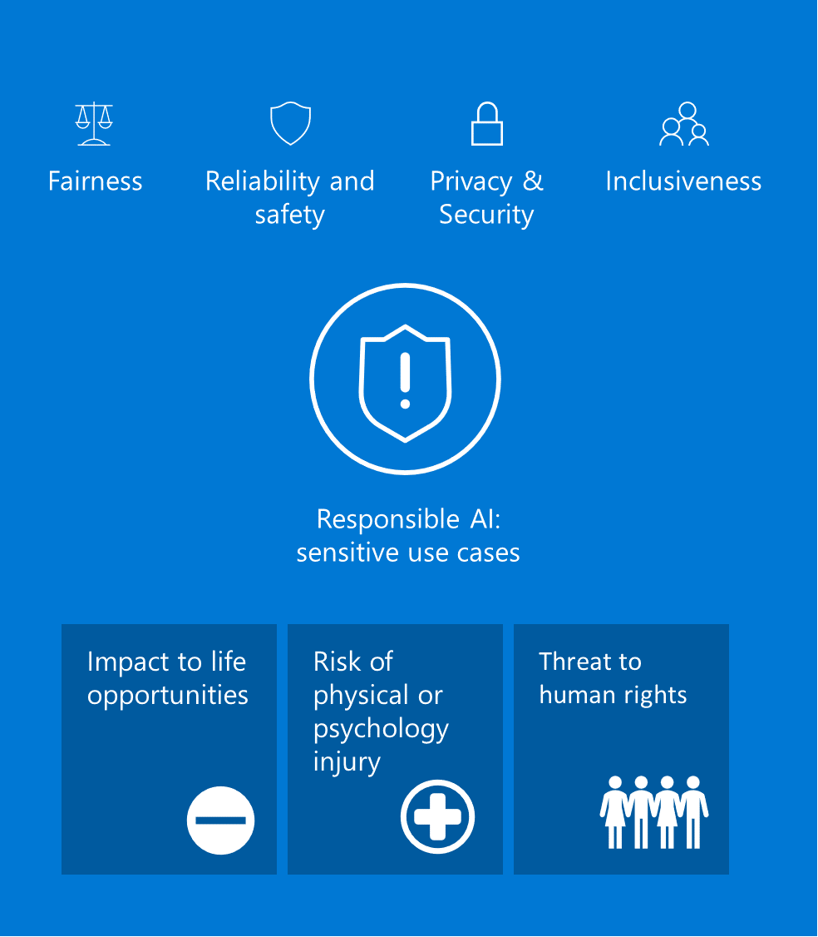
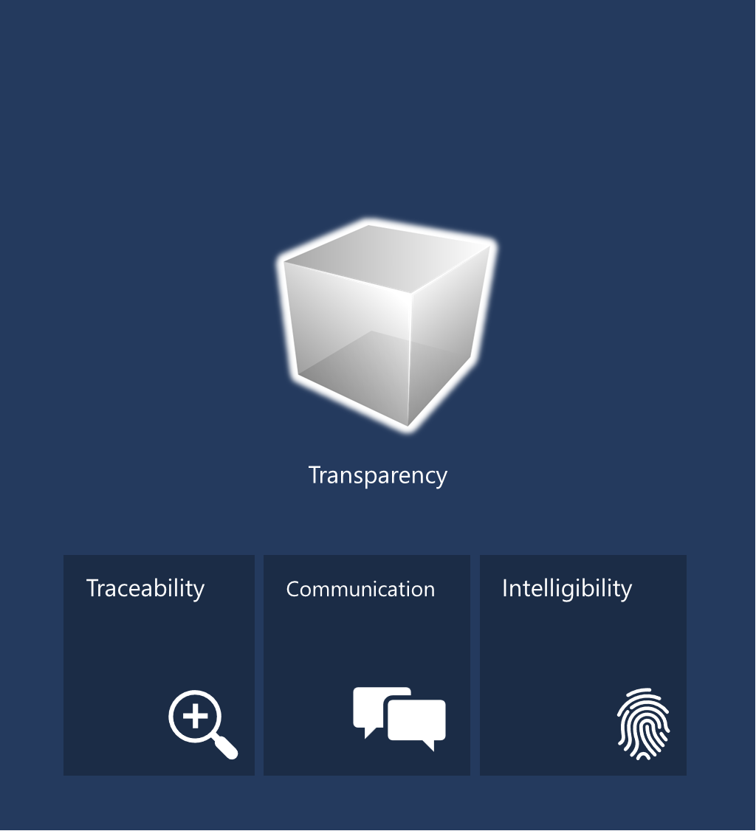
Change to improve AI solutions
Notes:
AI solution plays a crucial role in the wellbeing of individuals, communities, and businesses. This responsibility should not be taken lightly, and ML professionals should always be cognizant of the positive and negative impact they have on these groups. As AI is being used to influence these consequential decisions, it’s essential that it functions responsibly.
These practices help improve:
The prevention of treats to human rights
The prevention of discriminating or excluding certain group to life opportunities
The risk of physical or psychology injury
Underlying the preceding values are two foundational principles essential for ensuring the effectiveness of the rest: transparency and accountability. Since AI relies on extrapolated logic rather than hard-coded rules, it can sometimes function as a black box, where users don’t understand how the system’s outputs were derived from its inputs. But new regulations increasingly require developers or organizations to provide transparency about how their AI systems work.
For example, if a bank uses an AI system to support its consumer lending decisions, it is important to examine the training data and understand how that data influences the system’s recommendations. There are three components of transparency. First, transparency relies on a foundation of traceability, with teams clearly documenting their goals, definitions, design choices, and any assumptions made in development of the system.
Second, transparency requires communication—it’s important that those who are building and using AI systems are forthcoming about when, why, and how they choose to build and deploy them, as well as their systems’ limitations. The third facet of transparency is intelligibility. Intelligibility means that people should be able to fully understand and monitor the technical behavior of AI systems. This understanding helps data scientists evaluate and debug models and make informed decisions about how to improve
the model over time. It also helps executives, boards, employees, and customers determine how much to trust a model’s predictions or recommendations.
Accountability

Slide 7



What does this mean to you?
Machine Learning tools
Enable decision-makers
Improve people’s trust
Notes:
Our vision is to provide practical tools that enable data scientists and companies to continuously transform their Machine Learning life cycles to make debugging ML models faster for AI developers and business decision-makers take action with more confidence, while end-users gain trust. As a result, achieve more than they ever thought possible.

Slide 8
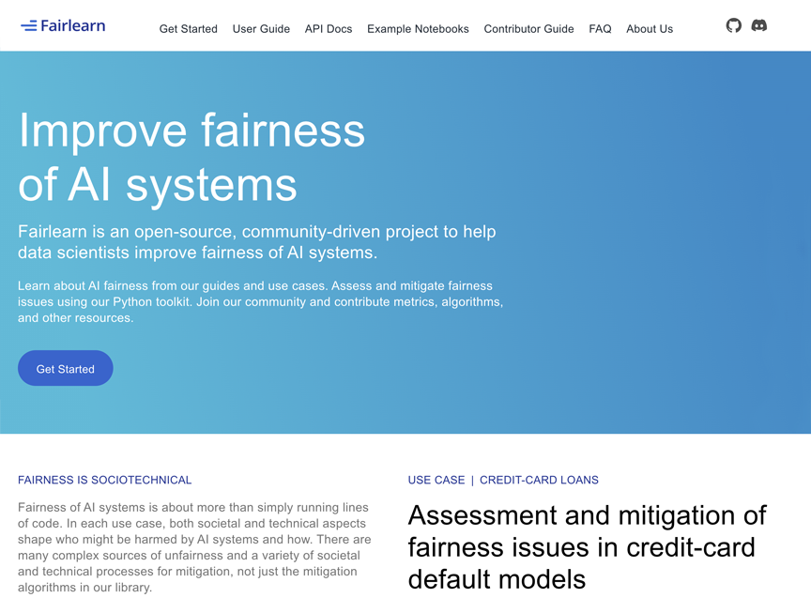
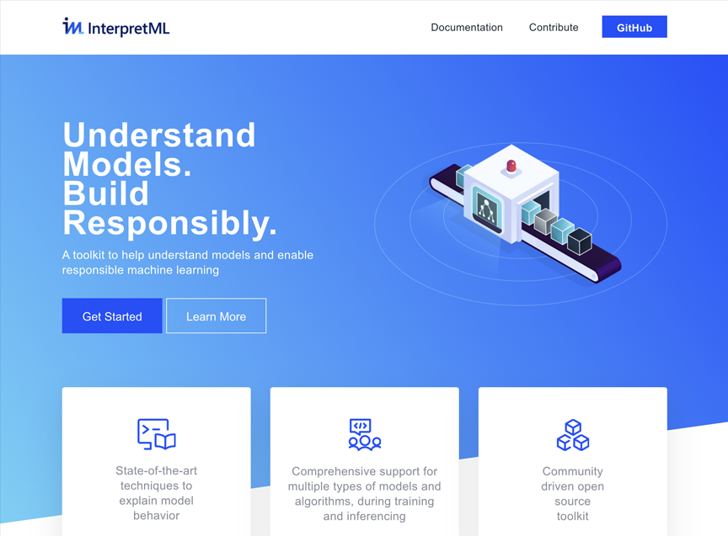
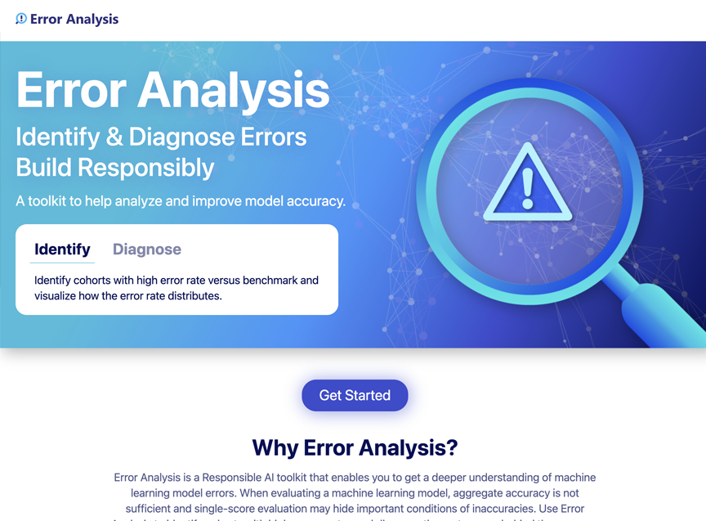
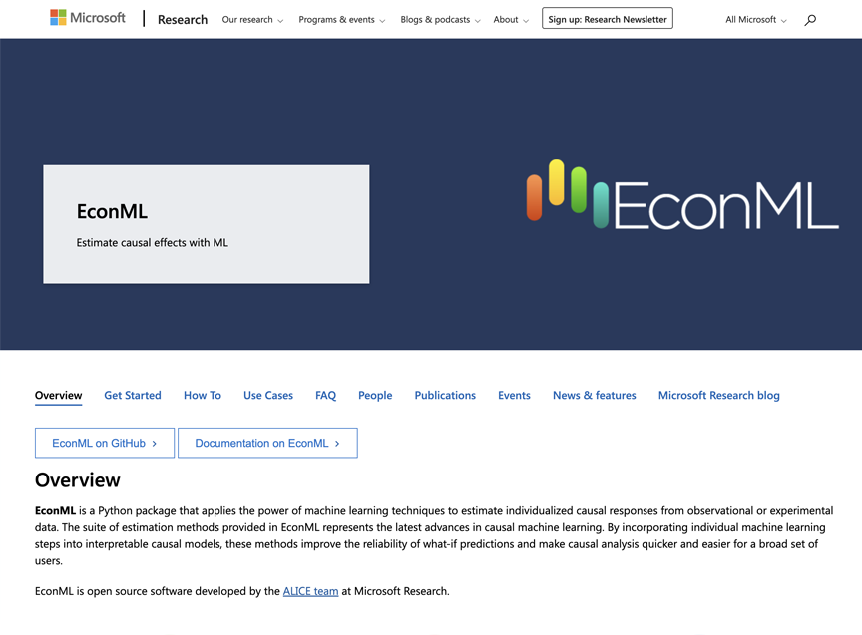
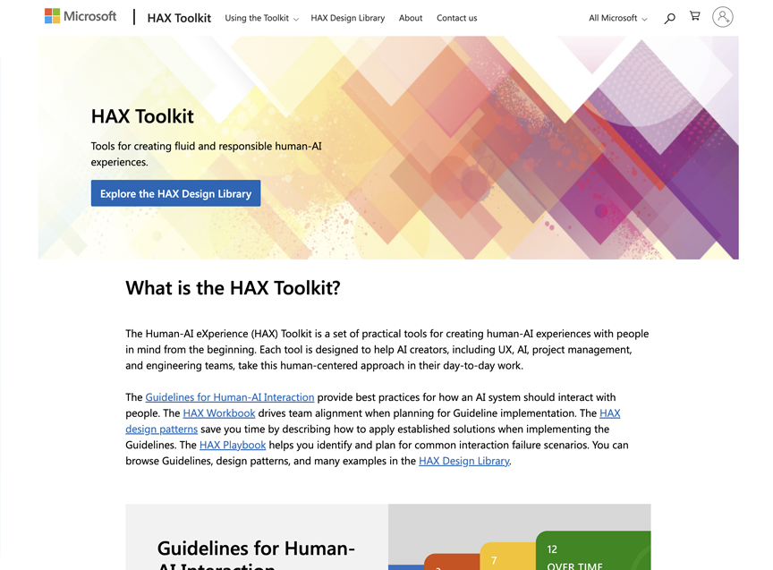

Tools: Pioneering new engineering practices
Fairlearn
InterpretML
Error Analysis
EconML
HAX Toolkit
Counterfit
Notes:
Microsoft is helping organizations take a more holistic approach to responsible AI across the development lifecycle by making available leading research, practical guidance and tooling innovation. These open-source tools developed by the leading academic institutions and organizations including Microsoft are instrumental for data scientists and AI developers to better understand model behavior, discover and mitigate undesirable issues from AI models.
We have also pioneered new engineering tools and practices. It is important emphasis that tooling alone is not capable of the deep, human-centered thinking work that needs to be done in conceiving of AI systems.
But we do think it is important to develop repeatable tools, patterns, and practices where possible, so that the creative thought of our engineering teams can be directed toward the most novel and unique challenges, not reinventing the wheel. Also, integrated systems and tools also help drive consistency and ensure that responsible AI is in the ‘coding path’ – it is part of the everyday way in which our engineering teams work.

Slide 9
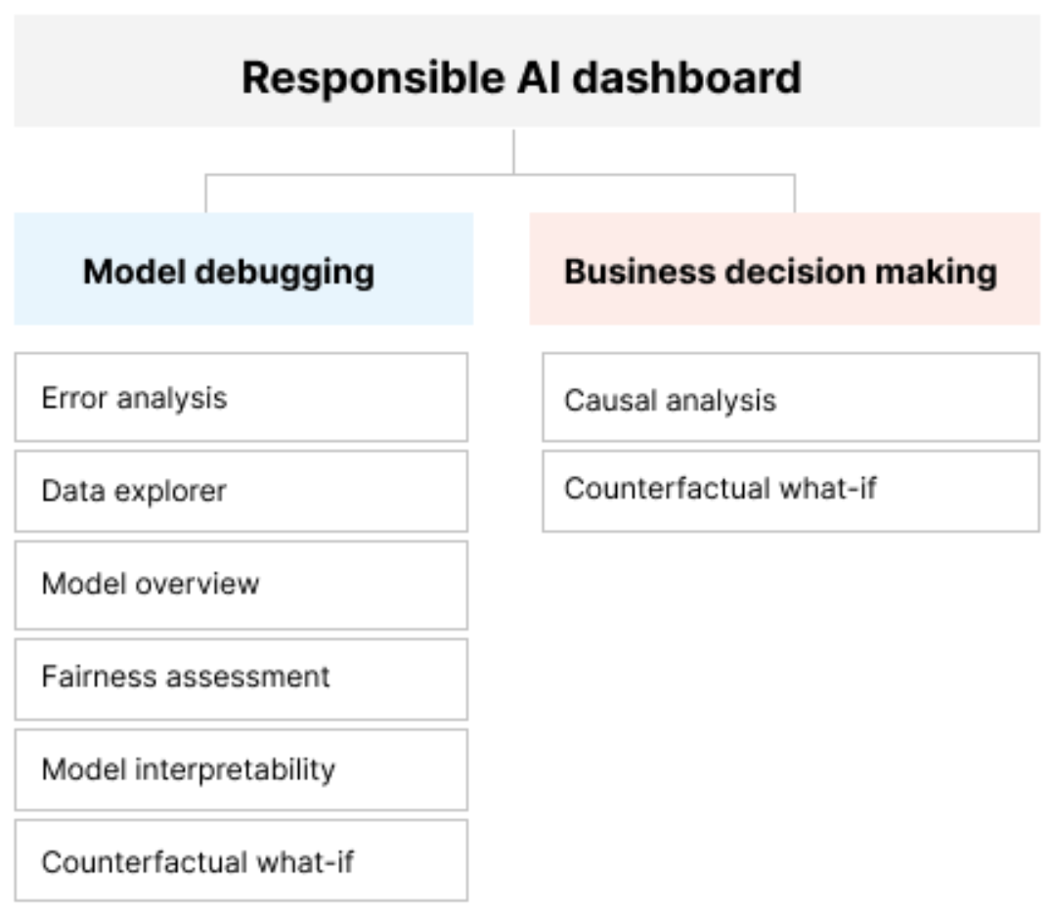
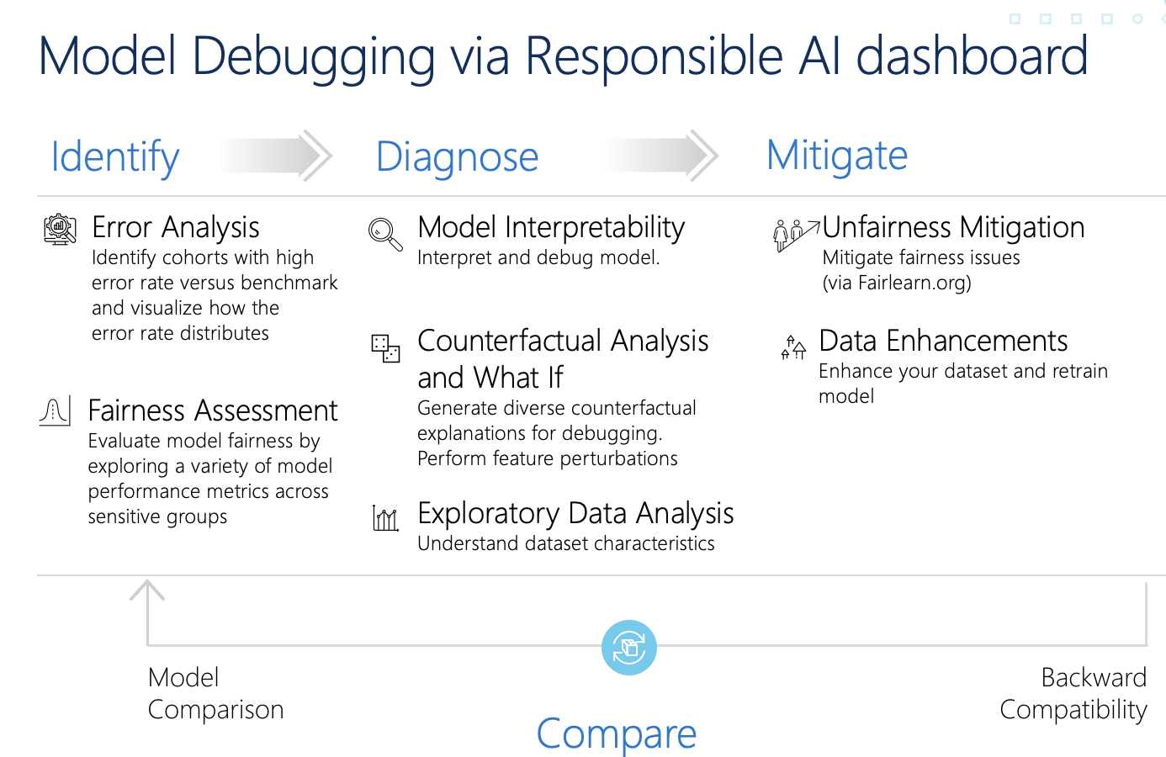
Enabling model debugging and decision-making
Mature Responsible AI Tools
Notes:
The responsible AI dashboard and scorecard pulls together some of the more mature responsible AI tooling developed by Microsoft or developed as part of an open-source project. The dashboard connects these capabilities such that they support mode debugging and support decision making in a point-and-click single pane of glass.
Under model debugging, the following capabilities are supported:
Error Analysis: allows us to diagnose model errors and give us an understanding of cohorts in our data that have a higher-than-average error rate. This comes in handy especially if you don't have access to demographic features in your data.
Data Explorer: allows users to explore data distributions. It allows users to quickly understand data balance issues (i.e., over/underrepresentation of groups in the data).
Model Overview: Model Overview is not necessarily novel but provides a view into assessing performance metrics differences across various subgroups in the data. Those metrics could include model accuracy, false positive and negative rates, recall, and precision of the model. The subgroups being assessed could be across demographic values or custom cohorts.
Fairness Assessment: allows users to assess fairness related harms such as quality of service harms (does the system work as well for one group of people as it does for another?) and allocation harms (does the system allocate opportunities or resources in ways that negatively impact people’s lives?). The assessment component allows users to assess how a model’s predictions affect different groups in the data. The tool provides several parity constraint capabilities that might be suitable for different fairness scenarios.
Model interpretability: contains a broad set of tools that include glassbox models that are naturally interpretable (GBMs, decision trees, logistic regression, etc.) and explainers for more complex models that include both global explainers (partial dependence plots, feature importance plots) and local explainers (SHAP, LIME). The explainers are mostly model agnostic but there are custom ones being developed for specific kinds of models including tree-based models, deep neural networks and text classifiers.
Counterfactual Analysis & What-if Analysis: What if analysis allows users to manually change the model input values for a specific observation in order to see the effect it has on the predicted probability or even the classification of that observation. Counterfactual analysis takes this a step further and automatically identifies the smallest possible change in the model input values that would flip the decision of the model. These two capabilities together allow us to not only assess whether small fluctuations in the input variables would lead to big changes in the output, but also identify the shortest path to a more desirable model outcome.
Under decision making, the following capabilities are supported:
Counterfactual Analysis: see above
Causal Analysis: allows users to assess the most important causal feature that directly affects the variable of interest. A causal effect is an observed relationship between two variables holding all else constant (or in other words, taking into consideration confounding factors). It helps users assess how an increase or change in one variable affects the variable of interest. Keep in mind that this analysis is done on the data and not on the model (with the exception of data explorer, all other previously mentioned capabilities assess the model and not the data)
These are a set of tools, patterns, and practices that help teams easily integrate responsible AI requirements into their everyday development practices.

Slide 10
Error Analysis

Slide 11
Traditional Model Debugging
Classification
Regression
Confusion Matrix
Accuracy
Recall
Precision
Mean Squared error (MSE)
Mean Absolute Error (MAE)
Root Mean Squared Error (RMSE)
Root Square (R2)
Notes:
Traditional model performance metrics used for measuring accuracy are mostly calculations. For example, a model is 93% accurate. Questions:
Is it 93% fair and inclusive? Which calculation measures fairness or inclusive?
Which calculation revels why the model is 7% of the time? Is it not importance?

Slide 12
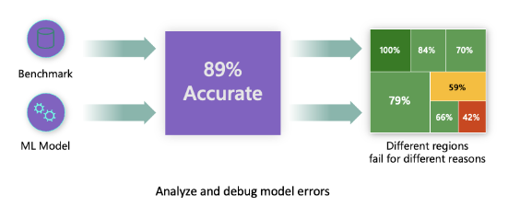
Challenge of finding model errors
Overall model accuracy not enough
Errors not uniformly distributed in the dataset
Different regions of the data causing model is fail
Notes:
The overall performance metrics such as classification’s accuracy, precision, recall or FI scores are good proxies to help you build trust with your model. However, further analysis and assessment is needed.
Errors are often not distributed uniformly in your underlying dataset. For instance, you may get an 89% model accuracy, but you might discover that when you dive deeper, you realize that there are different regions of your data for which the model is failing 58% of times. That’s where having the Error Analysis tool is crucial.

Slide 13
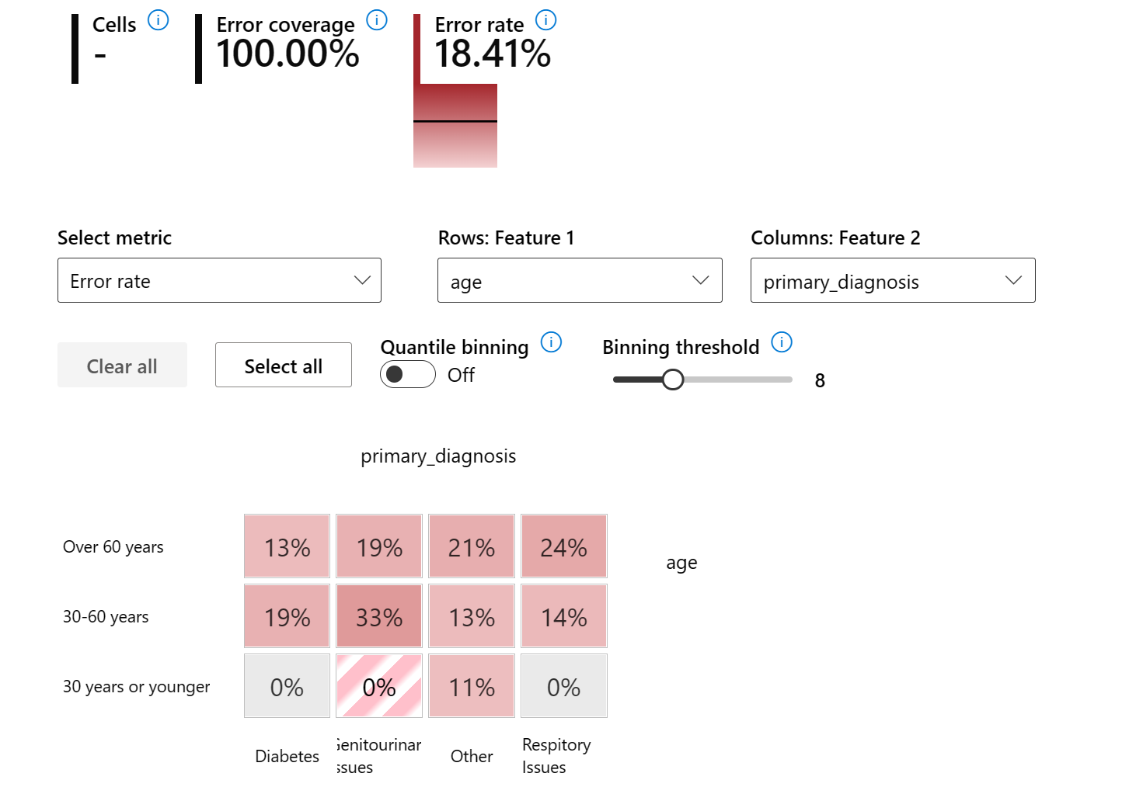
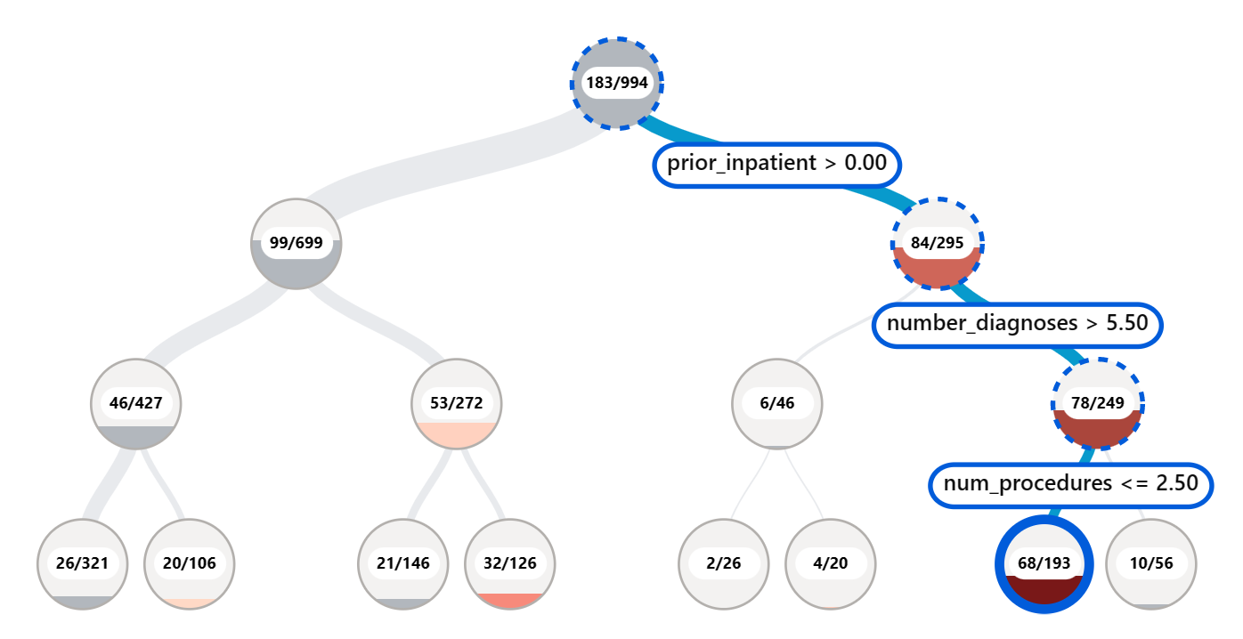
Identifying errors in your model
The RAI dashboard enables users to identify and create cohorts of data with high error rates from the Tree map and Heat map using the Error Analysis tool
Notes:
The Error Analysis tool on the Responsible AI dashboard helps you identify where the errors are. In addition, the gives users the ability to create cohorts of data to investigate why a model is performing poorly in some cohorts and not others.
By creating data cohorts, users are able to use model explanations and data explorer to investigate the reasons behind the error rates so you can take corrective actions.

Slide 14
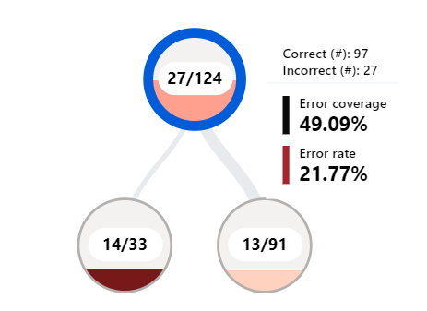
Interpreting the error insights
Incorrect vs Correct predictions
The number of incorrect vs correct predictions for the datapoints that fall in the node.
Error Rate
The percentage datapoints that fall in the node that are getting erroneous predictions.
The shade of red shows what percentage of this node’s datapoints are receiving erroneous predictions. The darker the red the higher the error rate.
Error Coverage
How many of your model’s overall errors are happening in this particular node.
The fullness of the node shows the coverage of errors the node has. The fuller the node, the higher error coverage it has.
Notes:
Each node represent a feature condition (e.g., number_diagnoses < 3)
Incorrect vs Correct predictions: The number of incorrect vs correct predictions for the datapoints that fall in the node.
Error Rate: The percentage of incorrect predictions divided by the size of data in the node (aka what percentage of datapoints that are falling in this node, are getting erroneous predictions). The shade of red shows what percentage of this node’s datapoints are receiving erroneous predictions. The darker the red the higher the error rate.
Error Coverage: The percentage of incorrect predictions in this node divided by the total number of incorrect predictions in the test datasets (aka how many of your model’s overall errors are happening in this particular node). The fullness of the node shows the coverage of errors the node has. The fuller the node, the higher error coverage it has.

Slide 15
Model Overview

Slide 16
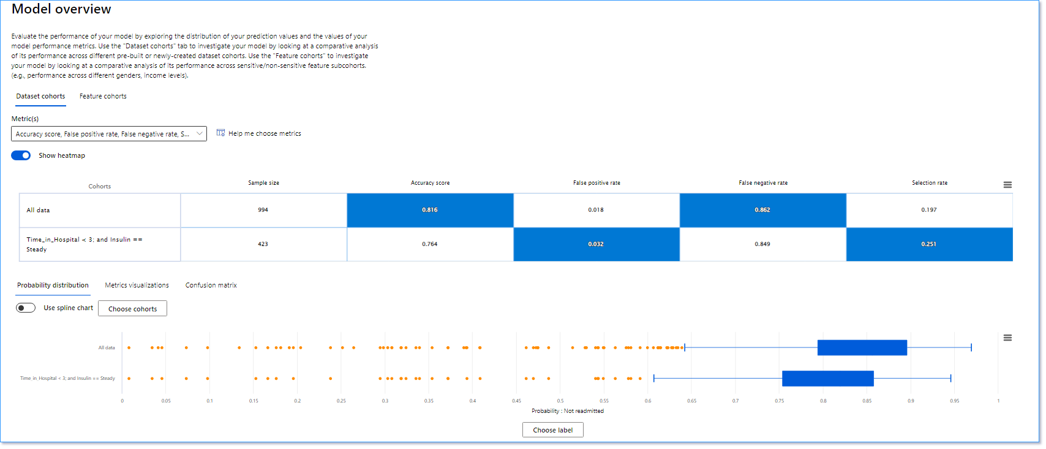
Evaluating model performance from cohorts
Providing ability to do comparative analysis to discover how the model is performing with one cohort vs another.
Disparity in model performance: These sets of metrics calculate the disparity (difference) in the values of the selected performance metric across subgroups of data. Here are a few examples:
Disparity in accuracy rate
Disparity in error rate
Disparity in precision
Disparity in recall
Disparity in mean absolute error (MAE)
Notes:
The RAI dashboard gives users the ability to do comparative analysis to helps shed light on how the model is performing with one subgroup of the dataset vs another.
For example, discovering that the model is more erroneous with a cohort that has sensitive features (e.g., patient race, gender or age) can help expose potential unfairness the model may have.

Slide 17
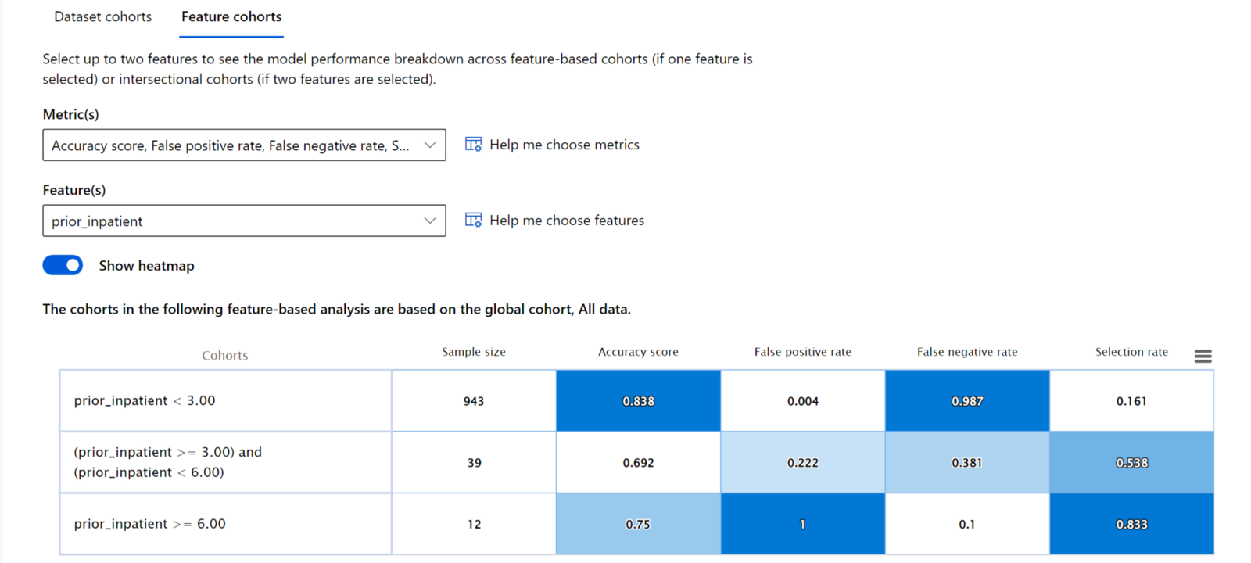
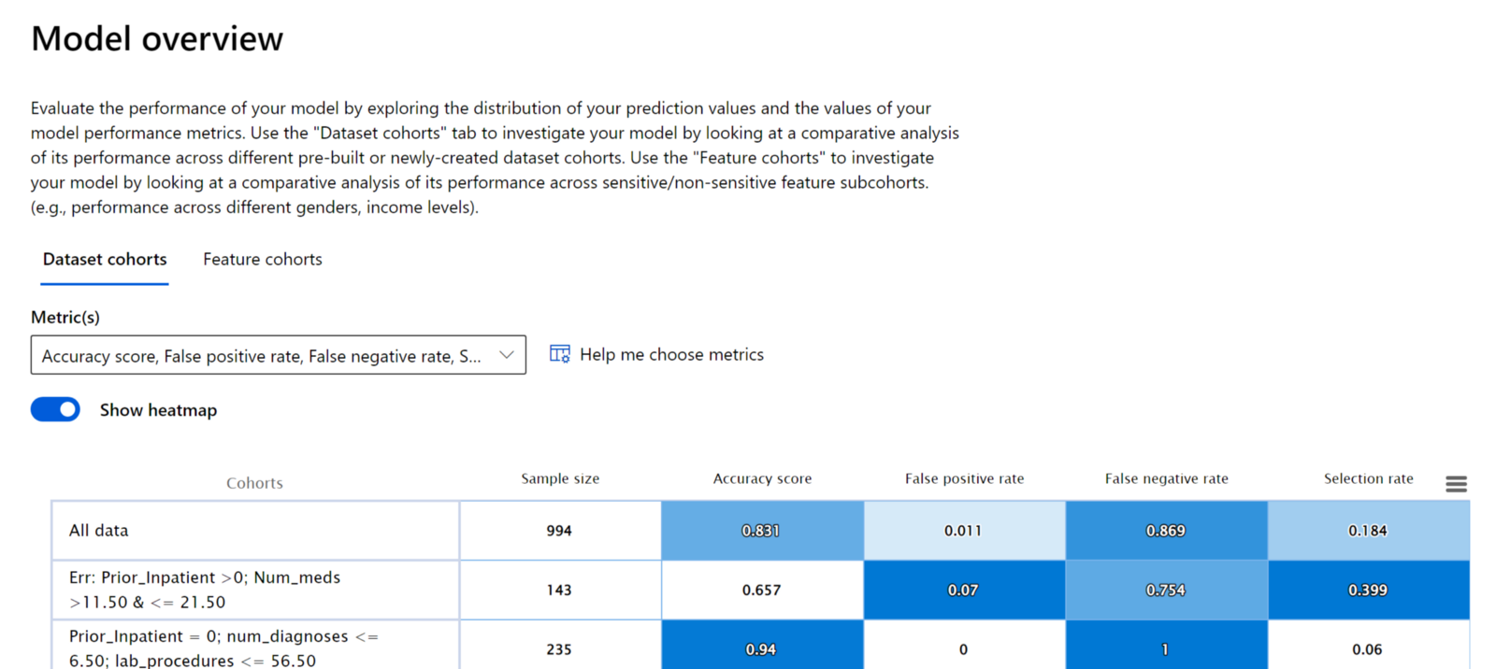
Dataset vs Feature-based cohort analysis
Providing ability for compare performance on an overall dataset cohort or feature-based cohort
Notes:
The RAI dashboard gives users the ability to examine the model performance across different the different cohorts that the user has created as well as within a specific feature. The dataset cohorts can contain 1 to many features. The Feature cohort selected can be 1 or 2 features.
On the Feature cohort's pane, users can investigate the model by comparing model performance across user-specified sensitive and non-sensitive features (for example, performance across patient age, diagnosis or insulin results). Whether it is one feature, or a combination of two features, the RAI dashboard has built-in intelligence to automatically generate feature values into various meaningful cohorts for users to do feature-based analysis and compare where the model is not doing well.

Slide 18
Finding disparities in model performance
Model fairness is quantified through disparity metrics during the assessment
Disparities among performance metric
Showing how model is performing for a given cohort using metrics such as Accuracy, Precision, Recall e.tc.
Probability distribution
Showing the probability of a given cohort to fall in a model’s predicted outcome.
Metric visualization
Showing performance scores for a given cohort

Slide 19
Data Analysis

Slide 20
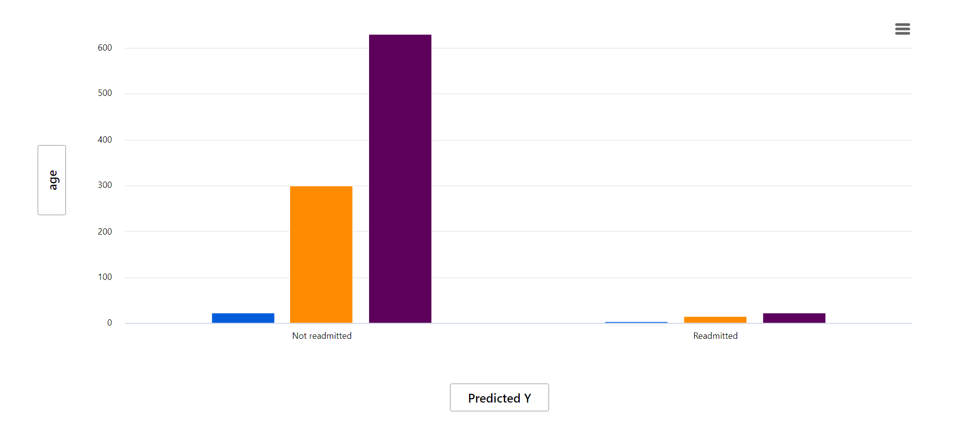
Discovering data disparities
Not having a good balance of data can negatively skew a model’s performance.
The Azure Responsible AI dashboard provides the Data Analysis tool for users to be able to visualize and explore potential fairness and reliability issues that could stem from data issues.
Notes:
The Azure Responsible AI dashboard includes a Data Analysis section for users to be able to explore and understand the dataset distributions and statistics. It provides an interactive user interface (UI) to enable users to visualize datasets based on the predicted and actual outcomes, error groups, and specific features. This is useful for ML professionals to be able to debug and identify issues of data over- and under-representation and to see how data is clustered in the dataset. As a result, they can understand the root cause of errors and any fairness issues introduced via data imbalances or lack of representation of a particular data group.

Slide 21
Uncovering data issues with Data Analysis
A major blind-spot and a very important part of model behavior is the actual data
Overrepresented or Underrepresented data
This leads to data biases causing the model to have fairness, inclusiveness, safety, or reliability issues.
Data quality
Examining data representation across cohorts can reveal errors that come from representation issues, label noise, feature noise, label bias, and similar factors.
Data isolation behavior
Explore your dataset statistics by selecting different filters to slice your data into different dimensions (cohorts)
Notes:
The traditional method of evaluating the trustworthiness of a model performance is looking at calculated metrics such as accuracy, recall, precision, mean square error, mean absolute error, r2 etc., depending on the type of use-case you have (e.g., Classification or Regression).
Data scientists or AI developers are able to measure the confidence level of areas the model correctly predicted or the frequency rate of making correct predictions.
Isolating your test data in separate cohorts to observe and compare how the model is performing with some groups vs others is another good technique.
However, all of these techniques ignore a major blind-spot and a very important part which is the actual data.

Slide 22
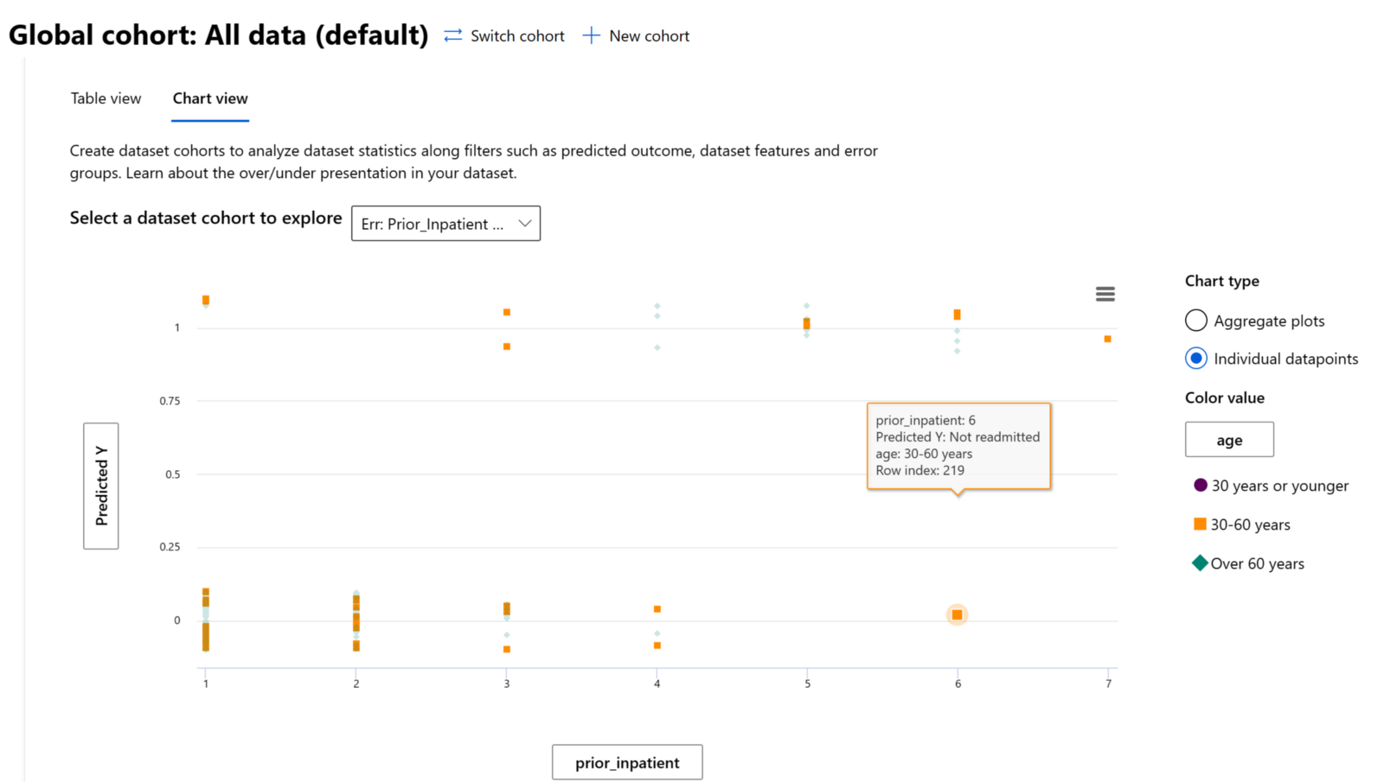
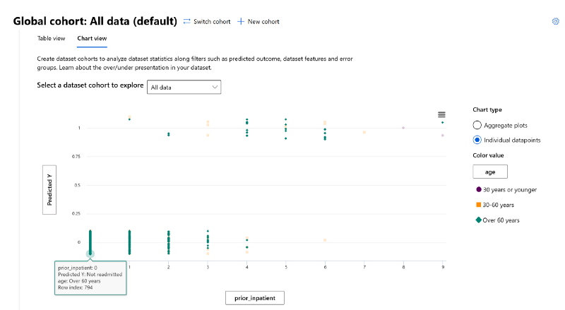
Data Analysis on an individual datapoint level
Ability to investigate data behavior by isolating individual datapoints for trends, consistency or outliers
Notes:
The RAI dashboard provides an individual data point view of the data as well. With this, you can investigate for data trends or outliers by isolating and examining individual data points.

Slide 23
Feature Importance

Slide 24
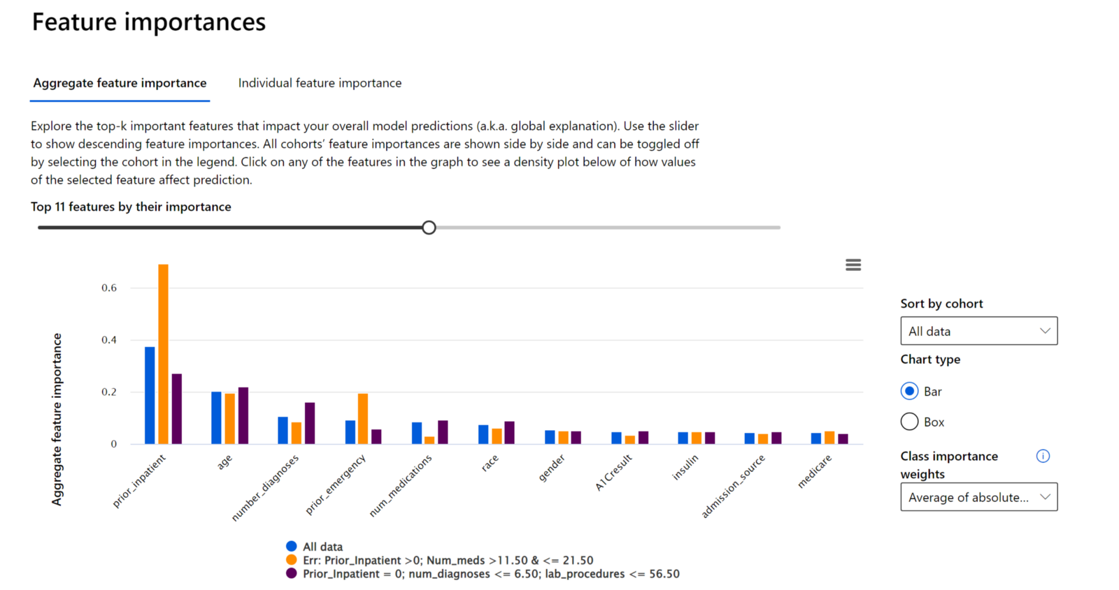
Understanding what driving a model’s predictions
The RAI dashboard gives users the ability to understand and explain a model’s behavior for transparency and accountability.
Helps answer model debugging questions:
Model debugging
Why did my model make this mistake? How can I improve my model?
Human-AI collaboration
How can I understand and trust the model’s decisions?
Human-AI collaboration
Does my model satisfy legal requirements?
Notes:
The RAI dashboard gives users the ability to understand and explain a model’s behavior for transparency and accountability. Users are able to see the top features driving the model’s predictions.
When you're using machine learning models in ways that affect people’s lives, it's critically important to understand what influences the behavior of models. Interpretability helps answer questions in scenarios such as:
Model debugging: Why did my model make this mistake? How can I improve my model?
Human-AI collaboration: How can I understand and trust the model’s decisions?
Regulatory compliance: Does my model satisfy legal requirements?

Slide 25
Provide Global and Local Explanations
The RAI dashboard gives users the overall or individual model explanability
Global Explanations
The dashboard displays the top features that drove the model’s overall predictions. E.g., What are the top factor impacting the model's overrall predictions?
Local Explanation
Shows which features drove a prediction for an individual data point. E.g., Why did patient X get readmitted in the hospital in less than 30 days?
Notes:
The Feature Importance to of the RAI dashboard provides an interactive user interface (UI) that enables data scientists or AI developers to see top features in their dataset that drove a model’s prediction. In addition, it provides both global explanations and local explanations. With global explanation, the dashboard displays the top features that drove the model’s overall predictions.
For local explanations, on the other hand, it shows which features drove a prediction for an individual data point. In our diabetes hospital readmission use case, every patient is different, so what drove the model to make a prediction for one patient can be different for another patient. The ability to explore local explanations is also helpful in debugging or auditing a specific case to better understand and interpret a model’s performance.

Slide 26
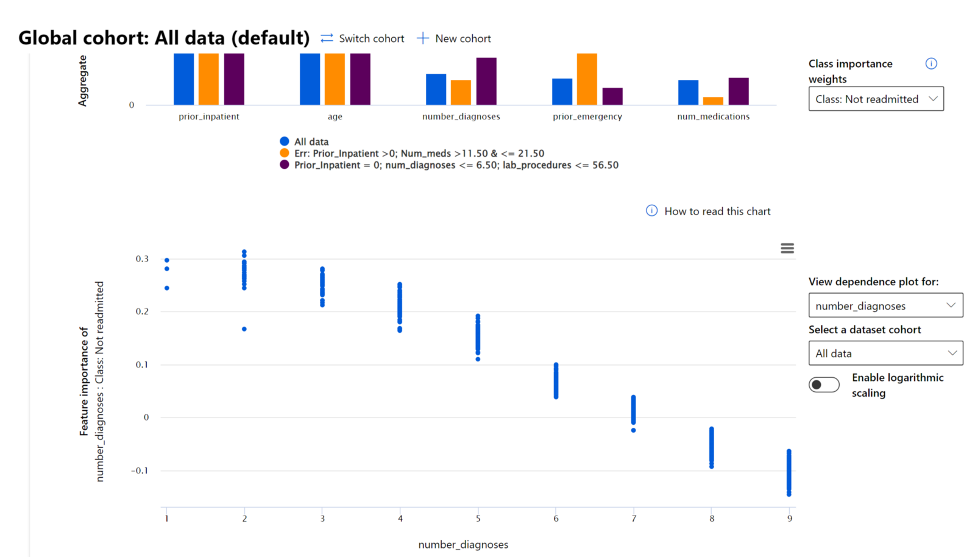
Exploring feature influence on model predictions
The RAI dashboard show which features are positively or negatively impacting predictions on individual data points.
Notes:
To provide full transparency, the RAI dashboard shows which features are positively or negatively impacting predictions on individual data points.
This is useful in identifying fairness issues if sensitive features are involved
This is also useful in cases where a stakeholder has to provide explanation to an end-user why a model make a prediction. For example, if a loan is declined, the load officer can show the customer what positive features led to the model’s outcome.

Slide 27
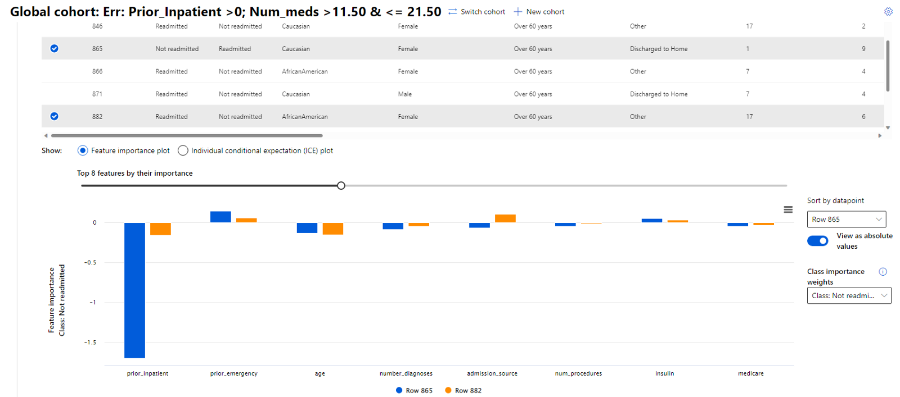
Assessing what feature impact model predictions

Slide 28
Thank You

